Slide 1
Magnetic Force on a Charged Particle

Slide 2
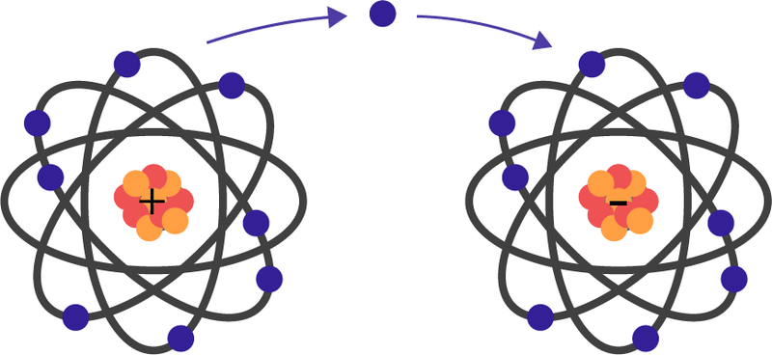
Current-carrying wire in a magnetic field will experience a magnetic force.
We use the right-hand slap rule to find the direction that the force acted in and we can also calculate the magnitude of the force.
In this lesson, we will look at what happens when a charged particle is put into a magnetic field.

Slide 3

By the end of this lesson, you should be able to:
Identify the direction that the magnetic force is acting in.
Calculate the magnitude of the magnetic force.

Slide 4
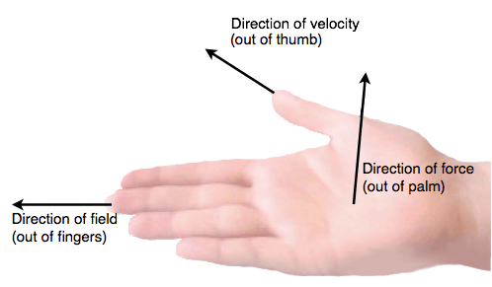
When a charged particle is in a magnetic field, it experiences a magnetic force. This force causes it to change direction.
You can use the right-hand slap rule again to find the direction that the magnetic force acts in.
For this version of the right-hand slap rule, your thumb points in the direction of the particle's velocity and your fingers point in the direction of the magnetic field. Then your palm points in the direction that the magnetic force acts in.

Slide 5
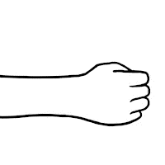
The key idea to remember when using the right-hand slap rule is that the charge on the particle has an impact on the direction you point your thumb in.
When a positively charged particle travels through a magnetic field, you point your thumb in the same direction that the particle is travelling.
When a negatively charged particle travels through a magnetic field, your thumb points in the opposite direction to the particle's motion.

Slide 6
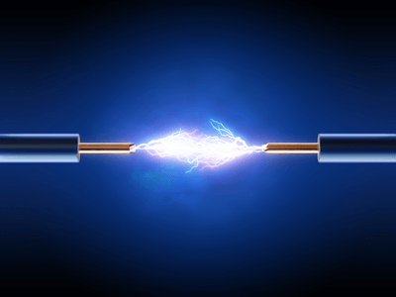
You should remember that objects accelerate when unbalanced forces act on them.
This means that when a magnetic force acts on a charged particle, it causes the particle to change direction and curve around.
This wasn't a problem for wires in magnetic fields because the current could only flow one way. When a magnetic force was applied to a wire it caused the whole wire to move but didn't affect the flow of current.

Slide 7
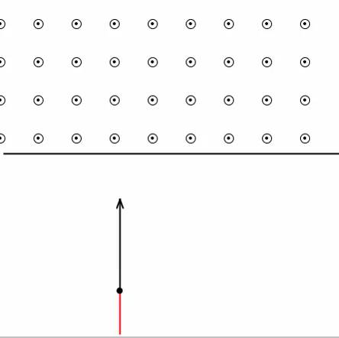
The magnetic force causes the charged particle to move in a circle.
Let's say a positively charged particle moves up and enters a magnetic field that points straight towards you. There will be a magnetic force acting on it that pushes the particle to your right (do the right-hand slap rule to check this).
Now the particle is moving in a different direction! Move your hand so that the thumb is pointing on a diagonal to the right. Now you can see that the magnetic force is acting in a different direction as well. This repeats many times to make the particle move in a circle.

Slide 8
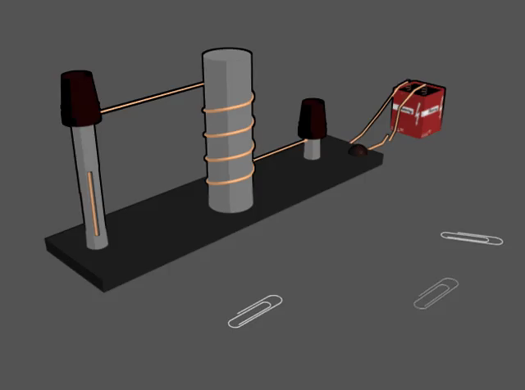
Now that you know how to find the direction that the magnetic force on a charged particle acts in, we can look at calculating the magnitude (size) of the magnetic force.
Just like the magnetic force on a current-carrying wire, the magnetic force is at a maximum when the magnetic field and the particle's motion are perpendicular.
When the particle's motion and magnetic field are parallel, there is no magnetic force.

Slide 9

We use this formula to calculate the magnitude of the magnetic force when the particle's motion and the magnetic field are perpendicular:
F=qvB
In this formula, q is the charge on the particle, v is the magnitude of the velocity of the particle and B is the magnitude of the magnetic field.
Notice that this formula only gives you the magnitude of the magnetic field; you still need to use the right-hand slap rule to find the direction that the force acts in.

Slide 10

Make sure you use the right units when you do these calculations.
Charge is measured in coulombs (C).
Velocity must be measured in metres per second (m/s).
Magnetic field must be in teslas (T).

Slide 11
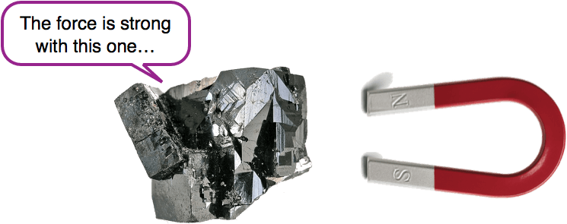
Be sure to check the units given to you in each question!
You probably won't be given magnetic field strength in teslas though - you are much more likely to be given it in microteslas (μT) or milliteslas (mT). This means that you will need to convert the magnetic field strength into teslas before doing the magnetic force calculation.
A millitesla is a thousandth of a tesla. This means that to convert milliteslas to teslas you need to divide by 1000.
Similarly, a microtesla is a millionth of a tesla. You divide by 1,000,000 to convert these into teslas.

